Slide 1

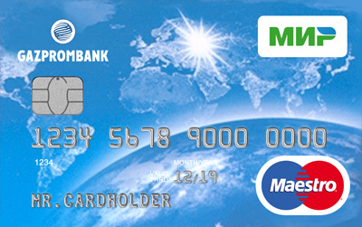
Salary card
«МИР — Maestro»
Get salary on the unique Bank card operating two payment systems simultaneously.
0РУБ.
0РУБ.
0РУБ.
Service of salary cards of «МИР — Maestro»
Maintenance of supplementary Bank cards
SMS notifications of transactions
Safe and secure
The national payment system «МИР» ensures smooth operations, and system operation is regulated by Russian Federal laws.
The card works all over Russia and abroad
You will be able to make purchases and withdraw cash wherever there are logos of payment systems «МИР», Maestro or MasterCard.

